Slide 1

Advanced Analytical Theory and Methods: Text Analysis
Author : FU
Date : Mar-2022

Slide 2
Objectives
After studying this chapter, the student should be able to understand Key Concepts:
Term
Corpus
Text normalization
TFIDF
Topic modeling
Sentiment analysis

Slide 3
Content
1 Text Analysis Steps
2 A Text Analysis Example
3 Collecting Raw Text
4 Representing Text
5 Term Frequency—Inverse Document Frequency (TFIDF)
6 Categorizing Documents by Topics
7 Determining Sentiments
8 Gaining Insights

Slide 4
Overview 1/2
Text analysis sometimes called text analytics, refers to the representation, processing, and modeling of textual data to derive useful insights.
An important component of text analysis is text mining, the process of discovering relationships and interesting patterns in large text collections.
Text analysis suffers from the curse of high dimensionality.
Take the popular children’s book Green Eggs and Ham as an example. Author Theodor Geisel (Dr. Seuss) was challenged to write an entire book with just 50 distinct words. He responded with the book Green Eggs and Ham, which contains 804 total words, only 50 of them distinct. These 50 words are:
a, am, and, anywhere, are, be, boat, box, car, could, dark, do, eat, eggs, fox, goat, good, green, ham, here, house, I, if, in, let, like, may, me, mouse, not, on, or, rain, Sam, say, see, so, thank, that, the, them, there, they, train, tree, try, will, with, would, you

Slide 5
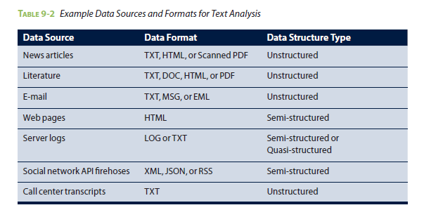
Overview 2/2
Another major challenge with text analysis is that most of the time the text is not structured.
This may include quasi-structured, semi-structured, unstructured data.

Slide 6
1 Text Analysis Steps
Usually consists of three important steps: parsing, search and retrieval, and text mining
Parsing is the process that takes unstructured text and imposes a structure for further analysis.
Search and retrieval is the identification of the documents in a corpus that contain search items such as specific words, phrases, topics, or entities like people or organizations
Text mining uses the terms and indexes produced by the prior two steps to discover meaningful insights pertaining to domains or problems of interest
Many of the techniques mentioned, such as clustering and classification, can be adapted to text mining. For example, the k-means and “Clustering” can be modified to cluster text documents into groups, where each group represents a collection of documents with a similar topic.
Text mining may utilize methods and techniques from various fields of study, such as statistical analysis, information retrieval, data mining, and natural language processing.

Slide 7
Part-of-Speech (POS) Tagging, Lemmatization, and Stemming 1/2
Goal of POS tagging is to build a model
whose input is a sentence, such as: he saw a fox
and whose output is a tag sequence.
Each tag marks the POS for the corresponding word, such as: PRP VBD DT NN
According to the Penn Treebank POS tags. The four words are mapped to pronoun personal), verb (past tense), determiner, and noun (singular), respectively.
Both lemmatization and stemming reduce the number of dimensions and reduce inflections or variant forms to the base form to more accurately measure the number of times each word appears.
Lemmatization finds the correct dictionary base form of a word by use of a given dictionary. For example, given the sentence:
obesity causes many problems output of lemmatization obesity cause many problem

Slide 8
Part-of-Speech (POS) Tagging, Lemmatization, and Stemming 2/2
Stemming does not need a dictionary, and it usually refers to a crude process of stripping affixes based on a set of heuristics with the hope of correctly achieving the goal to reduce inflections or variant form. After the process, words are stripped to become stems.
A stem is not necessarily an actual word defined in the natural language, but it is sufficient to differentiate itself from the stems of other words. A well-known rule-based stemming algorithm is Porter’s stemming algorithm. It defines a set of production rules to iteratively transform words into their stems.
For the sentence : obesity causes many problems
Output of Porter’s stemming algorithm is: obes caus mani problem

Slide 9
2 A Text Analysis Example 1/2
ACME can monitor the social media buzz using a simple process based on the three steps outlined in Section 9.1. This process is illustrated in Figure 9-1.
FIGURE 9-1 ACME’s Text Analysis Process

Slide 10
2 A Text Analysis Example 2/2
Collect raw text (Section 9.3). This corresponds to Phase 1 and Phase 2 of the Data Analytic Lifecycle.
Represent text (Section 9.4). Convert each review into a suitable document representation with proper indices, and build a corpus based on these indexed reviews
Compute the usefulness of each word in the reviews using methods such as TFIDF (Section 9.5). This and the following two steps correspond to Phases 3 through 5 of the Data Analytic Lifecycle.
Categorize documents by topics (Section 9.6).
Determine sentiments of the reviews (Section 9.7). Identify whether the reviews are positive or negative
Review the results and gain greater insights (Section 9.8). This step corresponds to Phase 5 and 6 of the Data Analytic Lifecycle.

Slide 11
3 Collecting Raw Text 1/3
Investigates the problem, understands the necessary data sources, and formulates initial hypotheses.
Collected before anything can happen. Data Science team monitor various websites for user-generated contents. User-generated contents being collected could be related articles from news portals and blogs, comments on ACME’s products from online shops or reviews sites, or social media posts, tweets that contain keywords bPhone or bEbook
Team would deal with semi-structured data such as HTML web pages, Really Simple Syndication (RSS) feeds, XML, orJavaScript Object Notation (JSON) files

Slide 12
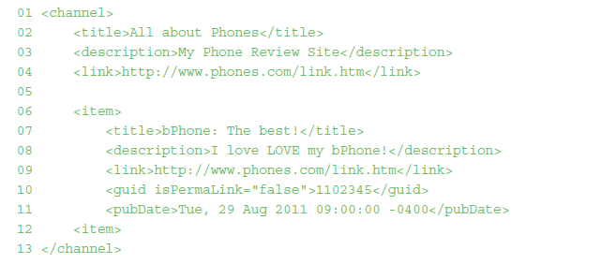
3 Collecting Raw Text 2/3
As an example, an RSS feed for a phone review blog is shown next.
The content from the title (line 7), the description (line 8), and the published date (pubDate, line 11) is what ACME is interested in
A web scraper is a software program (bot) that systematically browses the World Wide Web, downloads web pages, extracts useful information, and stores it somewhere for further study..

Slide 13
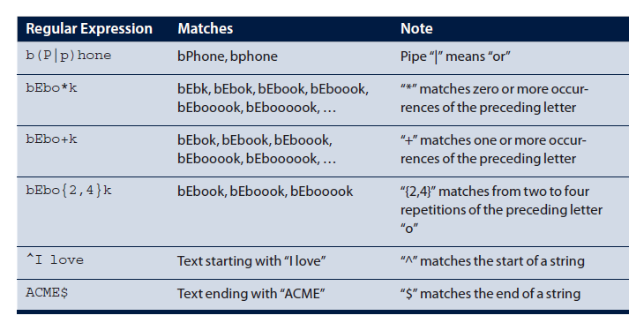
3 Collecting Raw Text 3/3
TABLE 9-3 Example Regular Expressions

Slide 14
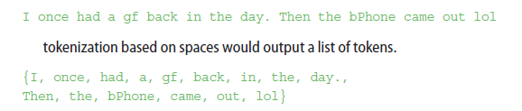
4 Representing Text 1/3
Text normalization
Tokenization is the task of separating (also called tokenizing) words from the body of text. Raw text is converted into collections of tokens after the tokenization, where each token is generally a word. A common approach is tokenizing on spaces. For example, with the tweet shown previously:
Case folding text normalization technique; reduces all letters to lowercase (or the opposite if applicable). For the previous tweet, after case folding the text would become this:
Represent text
bag-of-words : Bag-of-words is a common technique. But sometimes Data Science team prefers other methods of text representation that are more sophisticated. These more advanced methods consider factors such as word order, context, inferences, and discourse

Slide 15
4 Representing Text 2/3
Morphological features
term frequency (TF)
topic modeling
FIGURE 9-2 The 50 most frequent words in Shakespeare’s Hamlet

Slide 16
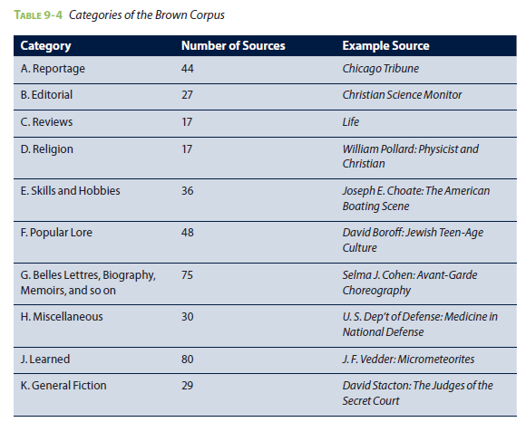
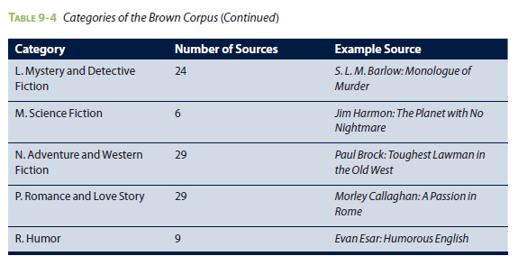
4 Representing Text 3/3

Slide 17
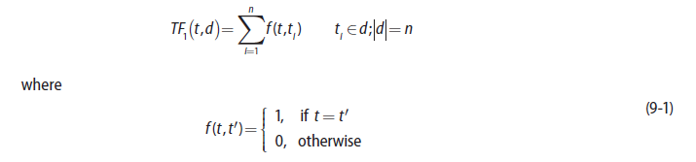
5 Term Frequency—Inverse Document Frequency (TFIDF) 1/8
TFIDF directly works on top of the fetched documents and treats these documents as the “corpus.” TFIDF is robust and efficient on dynamic content, because document changes require only the update of frequency counts.
Given a term t and a document d ={t₁, t₂, t₃,… } containing n terms, the simplest form of term frequency of t in d can be defined as the number of times t appears in d, as shown in Equation 9-1.

Slide 18
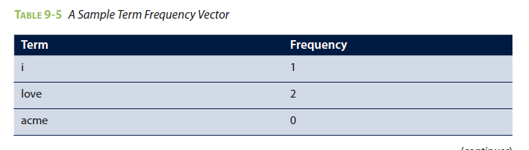
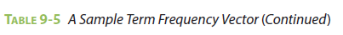
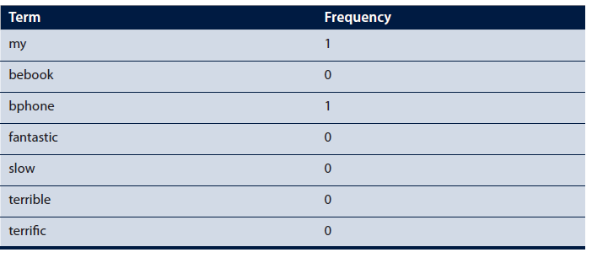
5 Term Frequency—Inverse Document Frequency 2/8
Consider a bag-of-words vector space of 10 words: i, love, acme, my, bebook, bphone, fantastic, slow, terrible, and terrific.
Given the text I love LOVE my bPhone extracted from the RSS feed in Section 9.3, Table 9-5 shows its corresponding term frequency vector after case folding and tokenization.

Slide 19

5 Term Frequency—Inverse Document Frequency 3/8
Term frequency function can be logarithmically scaled. Logarithm can be applied to word frequencies whose distribution also contains a long tail shown in Equation 9-2.
Longer documents contain more terms, tend to have higher term frequency values. They also tend to contain more distinct terms. These factors can conspire to raise the term frequency values of longer documents and lead to undesirable bias favoring longer documents. To address this problem, the term frequency can be normalized.
For example, the term frequency of term t in document d can be normalized based on the number of terms in d as shown in Equation 9-3.

Slide 20
5 Term Frequency—Inverse Document Frequency 4/8
A term frequency vector (shown in Table 9-5) can become very high dimensional because the bag-of words vector space can grow substantially to include all the words in English. The high dimensionality makes it difficult to store and parse the text and contribute to performance issues related to text analysis.
To reduce dimensionality, not all the words from a given language need to be included in the term frequency vector. E.g. In English, it is common to remove words such as the, a, of, and, to, and other articles that are not likely to contribute to semantic understanding.
Stop words: Words from a given language NOT need to be included in the term frequency vector.
Another simple yet effective way to reduce dimensionality is to store a term and its frequency only if the term appears at least once in a document. Any term not existing in the term frequency vector by default will have a frequency of 0. Therefore, the previous term frequency vector would be simplified to what is shown in Table 9-6.

Slide 21
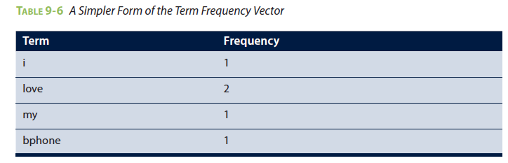
5 Term Frequency—Inverse Document Frequency 5/8
Some NLP techniques such as lemmatization and stemming can also reduce high dimensionality. Lemmatization and stemming are two different techniques that combine various forms of a word. With these techniques, words such as play, plays, played, and playing can be mapped to the same term.
It has been shown that the term frequency is based on the raw count of a term occurring in a standalone document. Term frequency by itself suffers a critical problem: It regards that stand-alone document as the entire world.

Slide 22
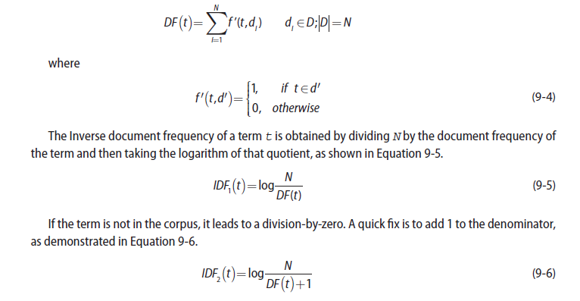
5 Term Frequency—Inverse Document Frequency 6/8
A quick fix for the problem is to introduce an additional variable that has a broader view of the world— considering the importance of a term not only in a single document but in a collection of documents, or in a corpus. The additional variable should reduce the effect of the term frequency as the term appears in more documents.
inverted document frequency (IDF) is the number of documents in the corpus that contain a term.
Let a corpus D contain N documents. The document frequency of a term t in corpus D= d₁,d₂ ,…d_{N} } is defined as shown in Equation 9-4.

Slide 23
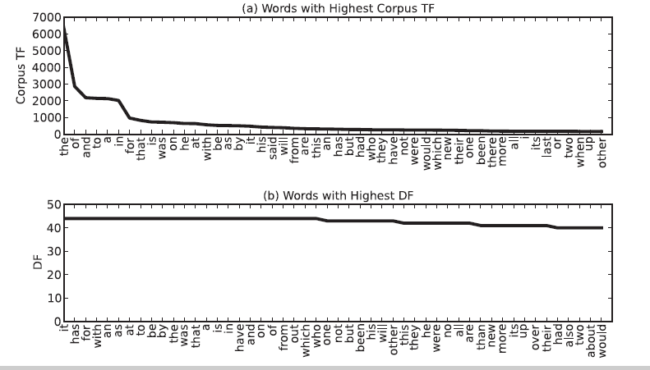
5 Term Frequency—Inverse Document Frequency 7/8
TFIDF scores words higher that appear more often in a document but occur less often across all documents in the corpus. Note that TFIDF applies to a term in a specific document, so the same term is likely to receive different TFIDF scores in different documents (because the TF values may be different).
FIGURE 9-3 Words from Brown corpus’s news category with the highest corpus TF, DF, or IDF

Slide 24
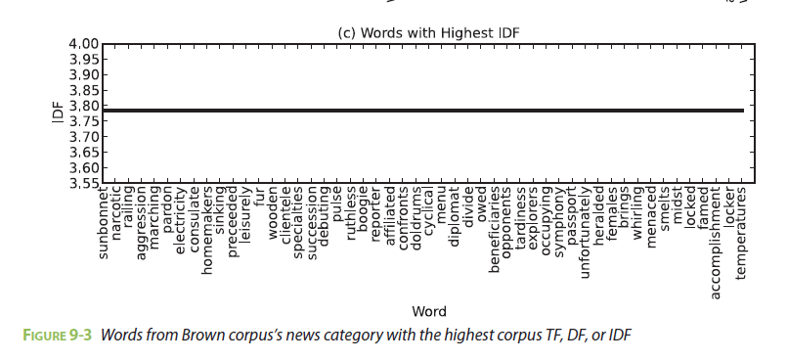
5 Term Frequency—Inverse Document Frequency 8/8
TFIDF is efficient in that the calculations are simple and straightforward, not require knowledge of the underlying meanings of the text. But this approach also reveals little of the inter-document or intra-document statistical structure. The next section shows how topic models can address this shortcoming of TFIDF.

Slide 25
6 Categorizing Documents by Topics 1/6
Topics of a document are not as straightforward as they might initially appear. Consider these two reviews:
1. The bPhone5x has coverage everywhere. It’s much less flaky than my old bPhone4G.
2. While I love ACME’s bPhone series, I’ve been quite disappointed by the bEbook. The text is illegible, and it makes even my old NBook look blazingly fast.
Is the first review about bPhone5x or bPhone4G? Is the second review about bPhone, bEbook, or NBook? For machines, these questions can be difficult to answer.
Intuitively, if a review is talking about bPhone5x, the term bPhone5x and related terms (such as phone and ACME) are likely to appear frequently.
A document typically consists of multiple themes running through the text in different proportions—for example, 30% on a topic related to phones, 15% on a topic related to appearance, 10% on a topic related to shipping, 5% on a topic related to service, and so on.

Slide 26
6 Categorizing Documents by Topics 2/6
Can be achieved with clustering methods such as k-means clustering or classification methods such as support vector machines, k-nearest neighbors, or naïve Bayes.
A more feasible and prevalent approach is to use topic modeling. Topic modeling provides tools to automatically organize, search, understand, and summarize from vast amounts of information.
Topic models are statistical models that examine words from a set of documents, determine the themes over the text, and discover how the themes are associated or change over time. The process of topic modeling can be simplified to the following.
1. Uncover the hidden topical patterns within a corpus.
2. Annotate documents according to these topics.
3. Use annotations to organize, search, and summarize texts.

Slide 27
6 Categorizing Documents by Topics 3/6
A topic is formally defined as a distribution over a fixed vocabulary of words. Different topics would have different distributions over the same vocabulary
latent Dirichlet allocation (LDA) – simplest model, a generative probabilistic model of a corpus proposed by David M. Blei and two other researchers. In generative probabilistic modeling, data is treated as the result of a generative process that includes hidden variables.
LDA assumes that there is a fixed vocabulary of words, and the number of the latent topics is predefined and remains constant. LDA assumes that each latent topic follows a Dirichlet distribution over the vocabulary, and each document is represented as a random mixture of latent topics.

Slide 28
6 Categorizing Documents by Topics 4/6
FIGURE 9-4 The intuitions behind LDA

Slide 29
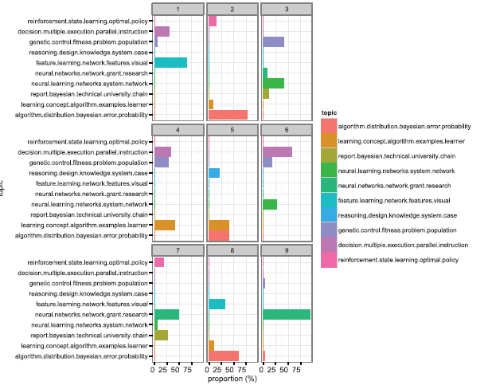
6 Categorizing Documents by Topics 5/6
FIGURE 9-5 Distributions of ten topics over nine scientific documents from the Cora dataset

Slide 30
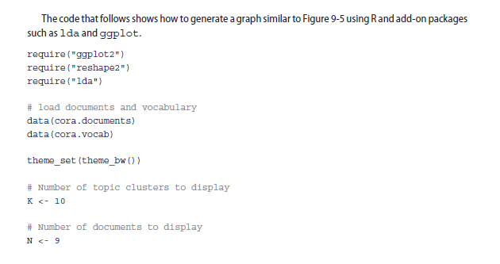
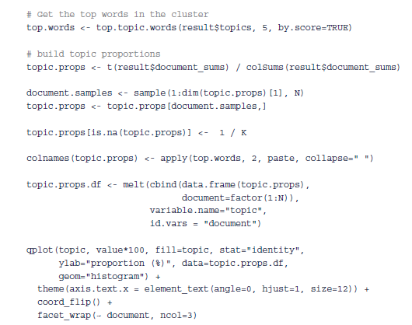
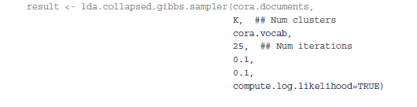
6 Categorizing Documents by Topics 6/6
Continue

Slide 31
7 Determining Sentiments 1/9
Sentiment analysis refers to a group of tasks that use statistics and natural language processing to mine opinions to identify and extract subjective information from texts.
Early work on sentiment analysis focused on detecting the polarity of product reviews from Epinions and movie reviews from the Internet Movie Database (IMDb) at the document level.
Later work handles sentiment analysis at the sentence level. More recently, the focus has shifted to phrase-level and short-text forms in response to the popularity of micro-blogging services such as Twitter.
Intuitively, to conduct sentiment analysis manually by constructing lists of words with positive sentiments (such as brilliant, awesome, and spectacular) and negative sentiments (such as awful, stupid, and hideous). Related work has pointed out that such an approach can be expected to achieve accuracy around 60%, and it is likely to be outperformed by examination of corpus statistics.

Slide 32
7 Determining Sentiments 2/9
Classification methods such as naïve Bayes, maximum entropy (MaxEnt), and support vector machines (SVM) are often used to extract corpus statistics for sentiment analysis. These classifiers can score around 80% accuracy on sentiment analysis over unstructured data. One or more of such classifiers can be applied to unstructured data, such as movie reviews or even tweets.
Depending on the classifier, data may need to be split into training and testing sets. A useful rule of the thumb for splitting data is to produce a training set much bigger than the testing set. For example, an 80/20 split would produce 80% of the data as the training set and 20% as the testing set.
Next, one or more classifiers are trained over the training set to learn the characteristics or patterns residing in the data. The sentiment tags in the testing data are hidden away from the classifiers. After the training, classifiers are tested over the testing set to infer the sentiment tags. Finally, the result is compared against the original sentiment tags to evaluate the overall performance of the classifier.

Slide 33
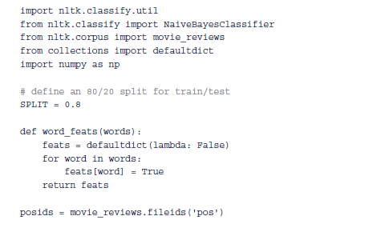
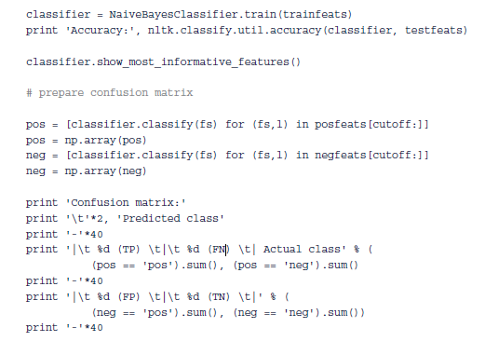
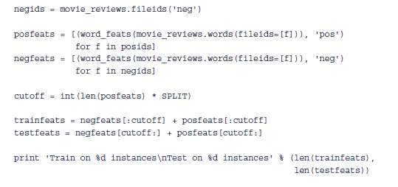
7 Determining Sentiments 3/9

Slide 34
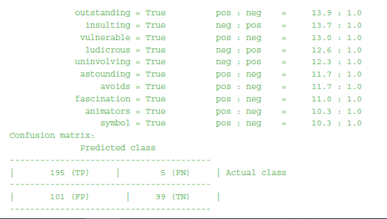
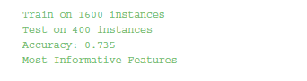
7 Determining Sentiments 4/9
Output that follows shows that the naïve Bayes classifier is trained on 1,600 instances and tested on 400 instances from the movie corpus. The classifier achieves an accuracy of 73.5%.

Slide 35
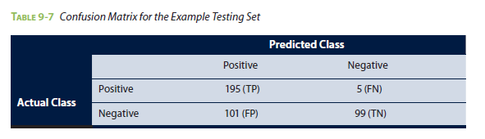
7 Determining Sentiments 5/9
A confusion matrix is a specific table layout that allows visualization of the performance of a model over the testing set. Every row and column corresponds to a possible class in the dataset.
Each cell in the matrix shows the number of test examples for which the actual class is the row and the predicted class is the column. Good results correspond to large numbers down the main diagonal (TP and TN) and small, ideally zero, off-diagonal elements (FP and FN).
Table 9-7 shows the confusion matrix from the previous program output for the testing set of 400 reviews.

Slide 36
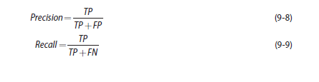
7 Determining Sentiments 6/9
Precision and recall are two measures commonly used to evaluate tasks related to text analysis. Definitions of precision and recall are given in Equations 9-8 and 9-9.
Precision is defined as the percentage of documents in the results that are relevant. If by entering
keyword bPhone, the search engine returns 100 documents, and 70 of them are relevant, the precision
of the search engine result is 0.7%.
Recall is the percentage of returned documents among all relevant documents in the corpus. If by
entering keyword bPhone, the search engine returns 100 documents, only 70 of which are relevant while
failing to return 10 additional, relevant documents, the recall is 70 / (70+10)=0.875.
Therefore, the naïve Bayes classifier from Table 9-7 receives a recall of 195 / (195+5)=0.975 and a
precision of 195/(195+101)≈0.659.

Slide 37
7 Determining Sentiments 7/9
FIGURE 9-6 Sentiment140 [41], an online tool for Twitter sentiment analysis

Slide 38
7 Determining Sentiments 8/9
Emoticons make it easy and fast to detect sentiments of millions or billions of tweets. However, using emoticons as the sole indicator of sentiments sometimes can be misleading, as emoticons may not necessarily correspond to the sentiments in the accompanied text.
For example, the sample tweet shown in Figure 9-7 contains the :) emoticon, but the text does not express a positive sentiment.
FIGURE 9-7 Tweet with the :) emoticon does not necessarily correspond to a positive sentiment

Slide 39
7 Determining Sentiments 9/9
FIGURE 9-8 Amazon Mechanical Turk

Slide 40
8 Gaining Insights 1/8
Corresponding to the data collection phase, Data Science team has used bPhone as the keyword to collect more than 300 reviews from a popular technical review website.
The 300 reviews are visualized as a word cloud after removing stop words. A word cloud (or tag cloud) is a visual representation of textual data. Tags are generally single words, and the importance of each word is shown with font size or color.
Figure 9-9 shows the word cloud built from the 300 reviews. The reviews have been previously case folded and tokenized into lowercased words, and stop words have been removed from the text.

Slide 41
8 Gaining Insights 2/8
FIGURE 9-9 Word cloud on all 300 reviews on bPhone
Fortunately, the popular technical review website allows users to provide ratings on a scale from one to five when they post reviews. The team can divide the reviews into subgroups using those ratings.

Slide 42
8 Gaining Insights 3/8
Figure 9-11 shows the word cloud of 70 one-star reviews. The words sim and button occur frequently enough that it would be advisable to sample the reviews that contain these terms and determine that is being said about buttons and SIM cards.
Word clouds can reveal useful information beyond the most prominent terms. For example, the graph in Figure 9-11 oddly contains words like stolen and Venezuela.
As the Data Science team investigates the stories behind these words, it finds that these words appear in 1-star reviews because there are a few unauthorized sellers from Venezuela that sell stolen bPhones. ACME can take further actions from this point.
This is an example of how text analysis and even simple visualizations can help gain insights.

Slide 43
8 Gaining Insights 4/8
FIGURE 9-10 Word cloud on five-star reviews
FIGURE 9-11 Word cloud on one-star reviews

Slide 44
8 Gaining Insights 5/8
TFIDF can be used to highlight the informative words in the reviews. Figure 9-12 shows a subset of the reviews in which each word with a larger font size corresponds to a higher TFIDF value.
Each review is considered a document. With TFIDF, data analysts can quickly go through the reviews and identify what aspects are perceived to make bPhone a good product or a bad product.
FIGURE 9-12 Reviews highlighted by TFIDF values

Slide 45
8 Gaining Insights 6/8
FIGURE 9-13 Ten topics on five-star reviews
FIGURE 9-14 Ten topics on one-star reviews

Slide 46
8 Gaining Insights 7/8
Figure 9-15 provides a different way to visualize the topics. Five topics are extracted from five-star reviews and one-star reviews, respectively. In an interactive environment, hovering the mouse on a topic highlights the corresponding words in this topic. The screenshots in Figure 9-15 were taken when Topic 4 is highlighted for both groups. The weight of a word in a topic is indicated by the disc size.
FIGURE 9-15 Five topics on five-star reviews (left) and 1-star reviews (right)

Slide 47
8 Gaining Insights 8/8
The Data Science team has also conducted sentiment analysis over 100 tweets from the popular microblogging site Twitter.
FIGURE 9-16 Sentiment analysis on Tweets related to bPhone

Slide 48
Summary
Discussed several subtasks of text analysis, including parsing, search and retrieval, and text mining.
With a brand management example, the chapter talks about a typical text analysis process:
(1) collecting raw text,
(2) representing text,
(3) using TFIDF to compute the usefulness of each word in the texts,
(4) categorizing documents by topics using topic modeling,
(5) sentiment analysis, and (6) gaining greater insights.
Overall text analysis is no trivial task. Corresponding to the Data Analytic Lifecycle, the most time consuming parts of a text analysis project often are not performing the statistics or implementing algorithms. Chances are the team would spend most of the time formulating the problem, getting the data, and preparing the data.

